Slide 1
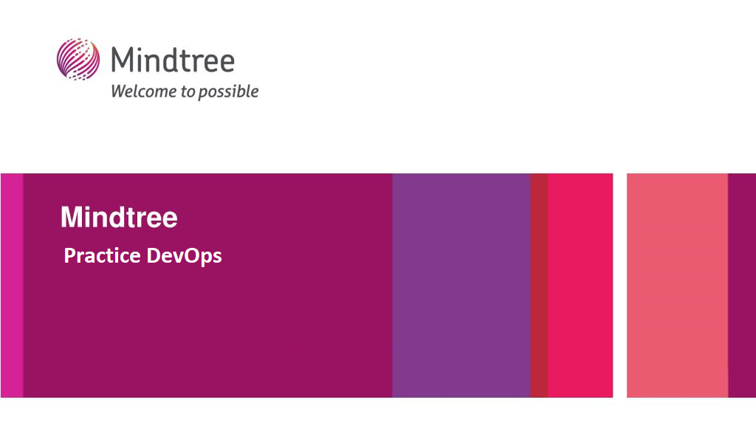

Slide 2
Deploying Hashicorp Vault Cluster using Terraform
Our use case is to create a vault server running in High Availability mode(HA) using raft as integrated backend storage and creation of dynamic AWS credentials.

Slide 3
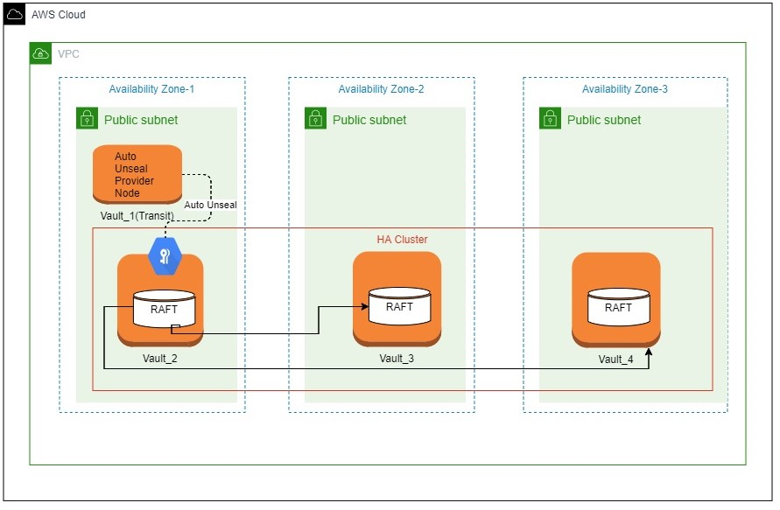
Architecture

Slide 4
Vault Server Configuration
Initially, vault_2 is initialized, unsealed, and has HA mode enabled. It is the only node in a cluster.
The remaining nodes, vault_3 and vault_4, have not joined its cluster.
We will manually join the vault_3 and vault_4 to the cluster.
Once we are done with joining the vault_3 and vault_4 , we can list the raft peers with a single leader(vault_2) and its followers(vault_3 and vault_4).

Slide 5
User Configuration in Vault
Create a policy with admin level access.
Create an user and assign the admin level policy to the user.
For security reasons, we login with the client token generated for that user , instead of using vault’s root token.

Slide 6
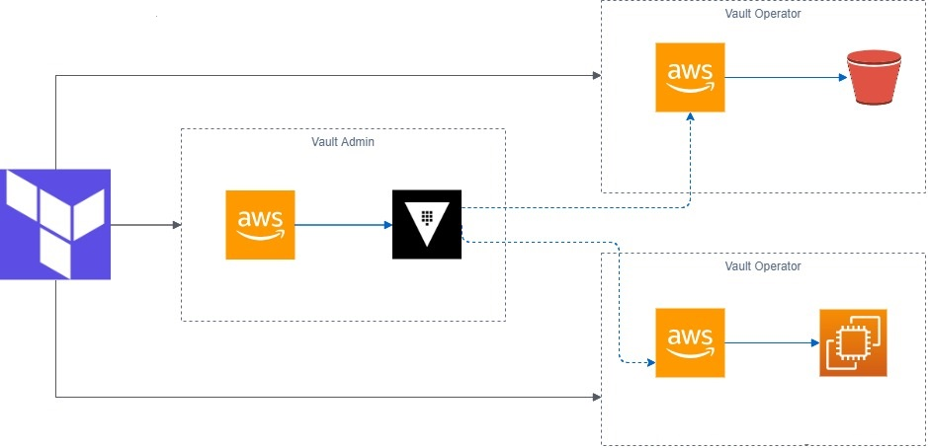
Inject secrets into Terraform using the Vault provider

Slide 7
Inject secrets into Terraform using the Vault provider
First, as an Vault Admin, you will configure AWS Secrets Engine in Vault.
Then, as a Terraform Operator, you will connect to the Vault instance to retrieve dynamic, short-lived AWS credentials generated by the AWS Secrets Engine to provision an Ubuntu EC2 instance and S3 bucket creation.

